Slide 1

Music and World Happiness
Analyzing Cultural Preferences through Spotify Data
Emily Aiken

Slide 2
Background
Music is well-known for its mood-enhancing properties
However, most empirical research on this topic is individual rather than global in scale
We will explore the relationship between musical preferences and levels of national happiness using data from Spotify and the 2024 World Happiness Report
Notes:
Music is well-known for its mood-enhancing properties
However, not much is known about how national musical preferences relate to societal well-being.
This project aims to use data from Spotify along with the 2024 World Happiness Report to explore whether musical characteristics and diversity can indicate different levels of national happiness.

Slide 3
Stakeholders & Constraints
Stakeholders include:
Academic researchers
Policy makers and cultural organizations
Music industry
Constraints
Can only establish correlation, not causation

Slide 4


Data
World Happiness Report 2024
Top Spotify Songs in 73 Countries
Notes:
Datasets used were:
World Happiness Report 2024
This is an annual report created in partnership with Gallup, the Oxford Wellbeing Research Centre, the UN Sustainable Development Solutions Network, and the World Happiness Report’s Editorial Board.
According to the World Happiness Report website, this report “reviews the state of happiness in the world today and shows how the science of happiness explains personal and national variations in happiness.”
Happiness rankings are based on individuals’ assessments of their lives. These responses are based on the question: “Please imagine a ladder, with steps numbered from 0 at the bottom to 10 at the top. The top of the ladder represents the best possible life for you and the bottom represents the worst possible life for you. On which step of the ladder would you say you personally feel you stand at this time?”
For the sake of clarity, throughout this presentation, I will be referring to the “ladder score” as the “happiness score.”
Top Spotify Songs in 73 Countries
This is a dataset created by Kaggle user Asaniczka using the Spotify API and is updated daily. It was first published on Kaggle in October 2023.
This dataset includes audio features for each track, including danceability, energy, and tempo, among others.

Slide 5
Data Wrangling & Key Takeaways

Slide 6
Exploratory Data Analysis & Key Findings

Slide 7
Modeling
We chose a binary classification modeling using the median happiness score (6.278) approach for the following reasons:
Simplification of complex data
Statistical considerations
Interpretability
Two classification models trained and tested:
Logistic Regression
Random Forest Classification
Notes:
For modeling, I chose to use a binary classification approach using the median happiness score.
In other words, the model that I ended up using would classify countries into groups above or below the median.
I chose this route for the following reasons [LIST ALL THREE BEFORE MOVING ON]:
Simplification of complex data
Converting happiness scores into above/below median groups helps identify clear patterns in how musical characteristics distinguish between happier and less happy countries.
This approach reduces the impact of small variations in happiness scores that might not be meaningful.
Statistical considerations
With only 71 countries, binary classification is more reliable than trying to predict exact happiness scores.
The median provides a natural splitting point that ensures balanced classes.
Interpretability
Binary classification makes results more actionable and easier to understand.
We can clearly identify which musical features are associated with above-median happiness.
Results are more robus given our sample size than trying to predict exact happiness scores.
We trained and tested two classification models:
Logistic Regression, since it is a simple and interpretable model that works well with small datasets.
Random Forest Classification, since it has a good balance between model complexity and interpretability. If Random Forest outperforms Logistic Regression, that implies that relationships between musical features and happiness are more complex.

Slide 8
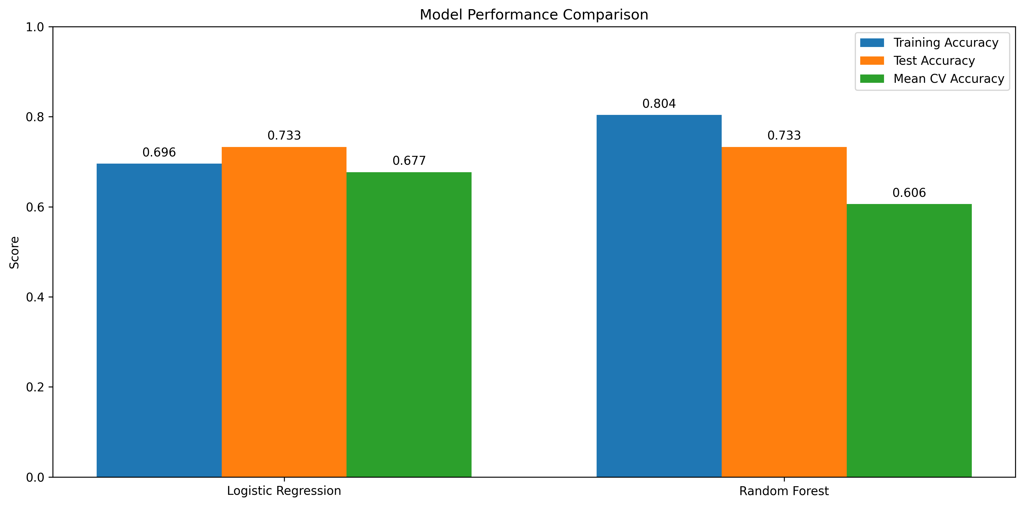
Modeling
We favored the Logistic Regression model over the Random Forest Classification model.
Notes:
After training and testing both models, we favored Logistic Regression.
While both models achieved the same test accuracy, Logistic Regression showed more stable cross-validation performance and better interpretability of feature relationships.
Furthermore, Random Forest shows a larger gap between training accuracy and test accuracy, suggesting overfitting. Logistic Regression’s smaller gap between training and test accuracy indicates that it generalizes better to new data.

Slide 9
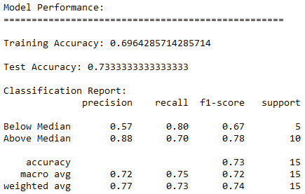
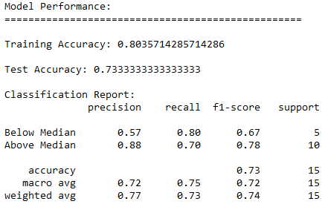


Modeling
Logistic Regression
Random Forest Classification
Notes:
In both cases:
Both models achieved identical test accuracy (73.3%) in classifying countries as above or below median happiness.
Both models were better at identifying happier countries (88% precision) than less happy ones.

Slide 10
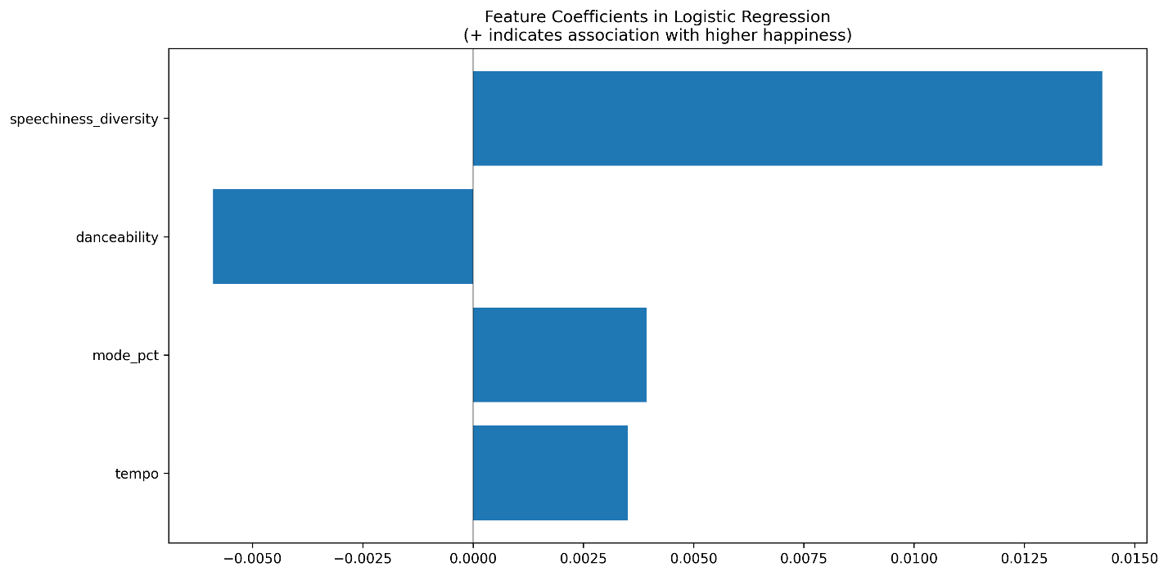
Analysis Results
(Percentage of major-key songs)
Notes:
Musical diversity emerged as the strongest predictor.
Countries with greater diversity in speech-like music elements tended to be happier. This could reflect greater cultural openness or diversity in musical expression.
The proportion of major key songs showed a positive influence.
Happier countries tended to listen to more songs in major keys.
In our chart, the percentage of major key songs is indicated by the variable name mode_pct.
Danceability, perhaps counterintuitively, showed a negative relationship with happiness.
Countries who listen to less danceable music ironically tend to be happier.
Perhaps less happy countries listen to danceable music as a form of escapism from harsh living conditions.

Slide 11
Recommendations

Slide 12
Improvements & Future Work
Data expansion
Gather longitudinal data
Include more countries in our analysis
Methodological improvements
Consider multi-class classification
Notes:
While our analysis did yield some interesting findings, it was unfortunately hampered due to the small size of the dataset we worked with. This could be improved by data expansion. Some ways to do this:
Gather longitudinal data. Future research would benefit from gathering data across multiple years to track data over time. Assuming our Spotify dataset will continue to be updated daily into the future, this will be possible in future years as the World Happiness Foundation continues to release annual reports.
Include more countries in our analysis. The United Nations recognizes 193 countries; of whom, 180 have access to Spotify. Our dataset, however, was limited to only 73 countries; two of which, unfortunately, were not included in our World Happiness dataset. Future analysis would benefit from including the full breadth of countries representing Spotify’s userbase.
Future renditions of this study could also be improved methodologically. This would entail:
Considering multi-class classification. Rather than simply dividing countries into two groups (above or below median happiness), we could divide them into multiple groups, such as happiness quartiles (happiest 25%, second happiest 25%, etc.)
Incorporate cultural and economic controls. To add depth to our analysis, we could include cultural dimensions (such as individualism vs. collectivism), religious or linguistic diversity metrics, education levels, and urban vs. rural population ratios. By controlling for these factors, we could better understand whether the relationship between music and happiness exists independently of these other influences.

